Slide 1
Linear Algebra
线性代数
Zongbin Chen YMSC, Tsinghua University
陈宗彬 清华大学数学科学中心
Email: zbchen@tsinghua.edu.can

Slide 2
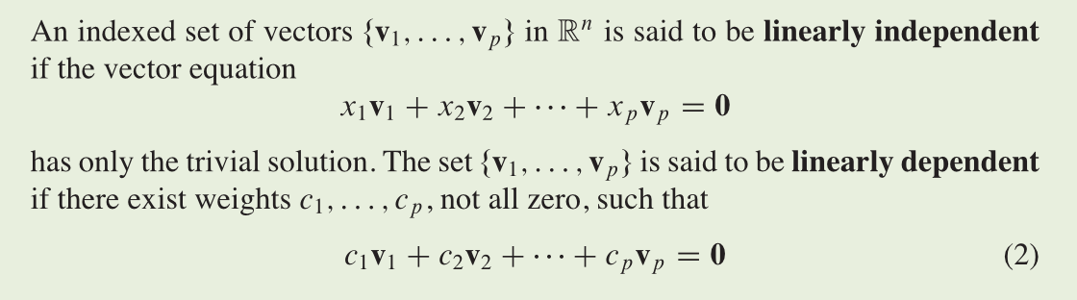


Quick review
Definition: linear independent(线性无关), linear dependent(线性相关)

Slide 3
Reformulation

Slide 4
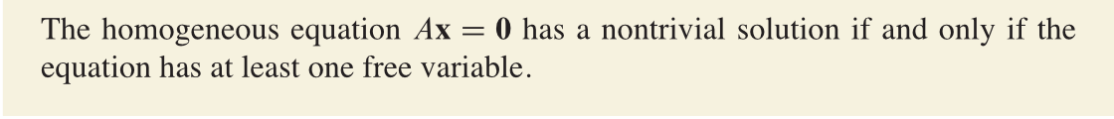
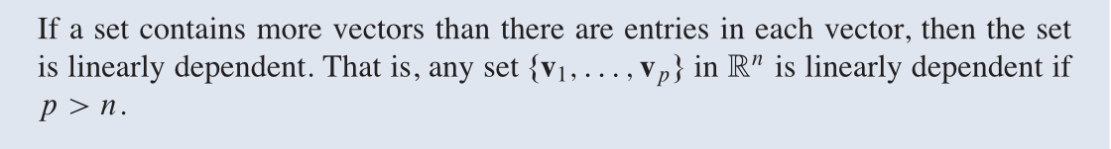
Theorem
Theorem

Slide 5
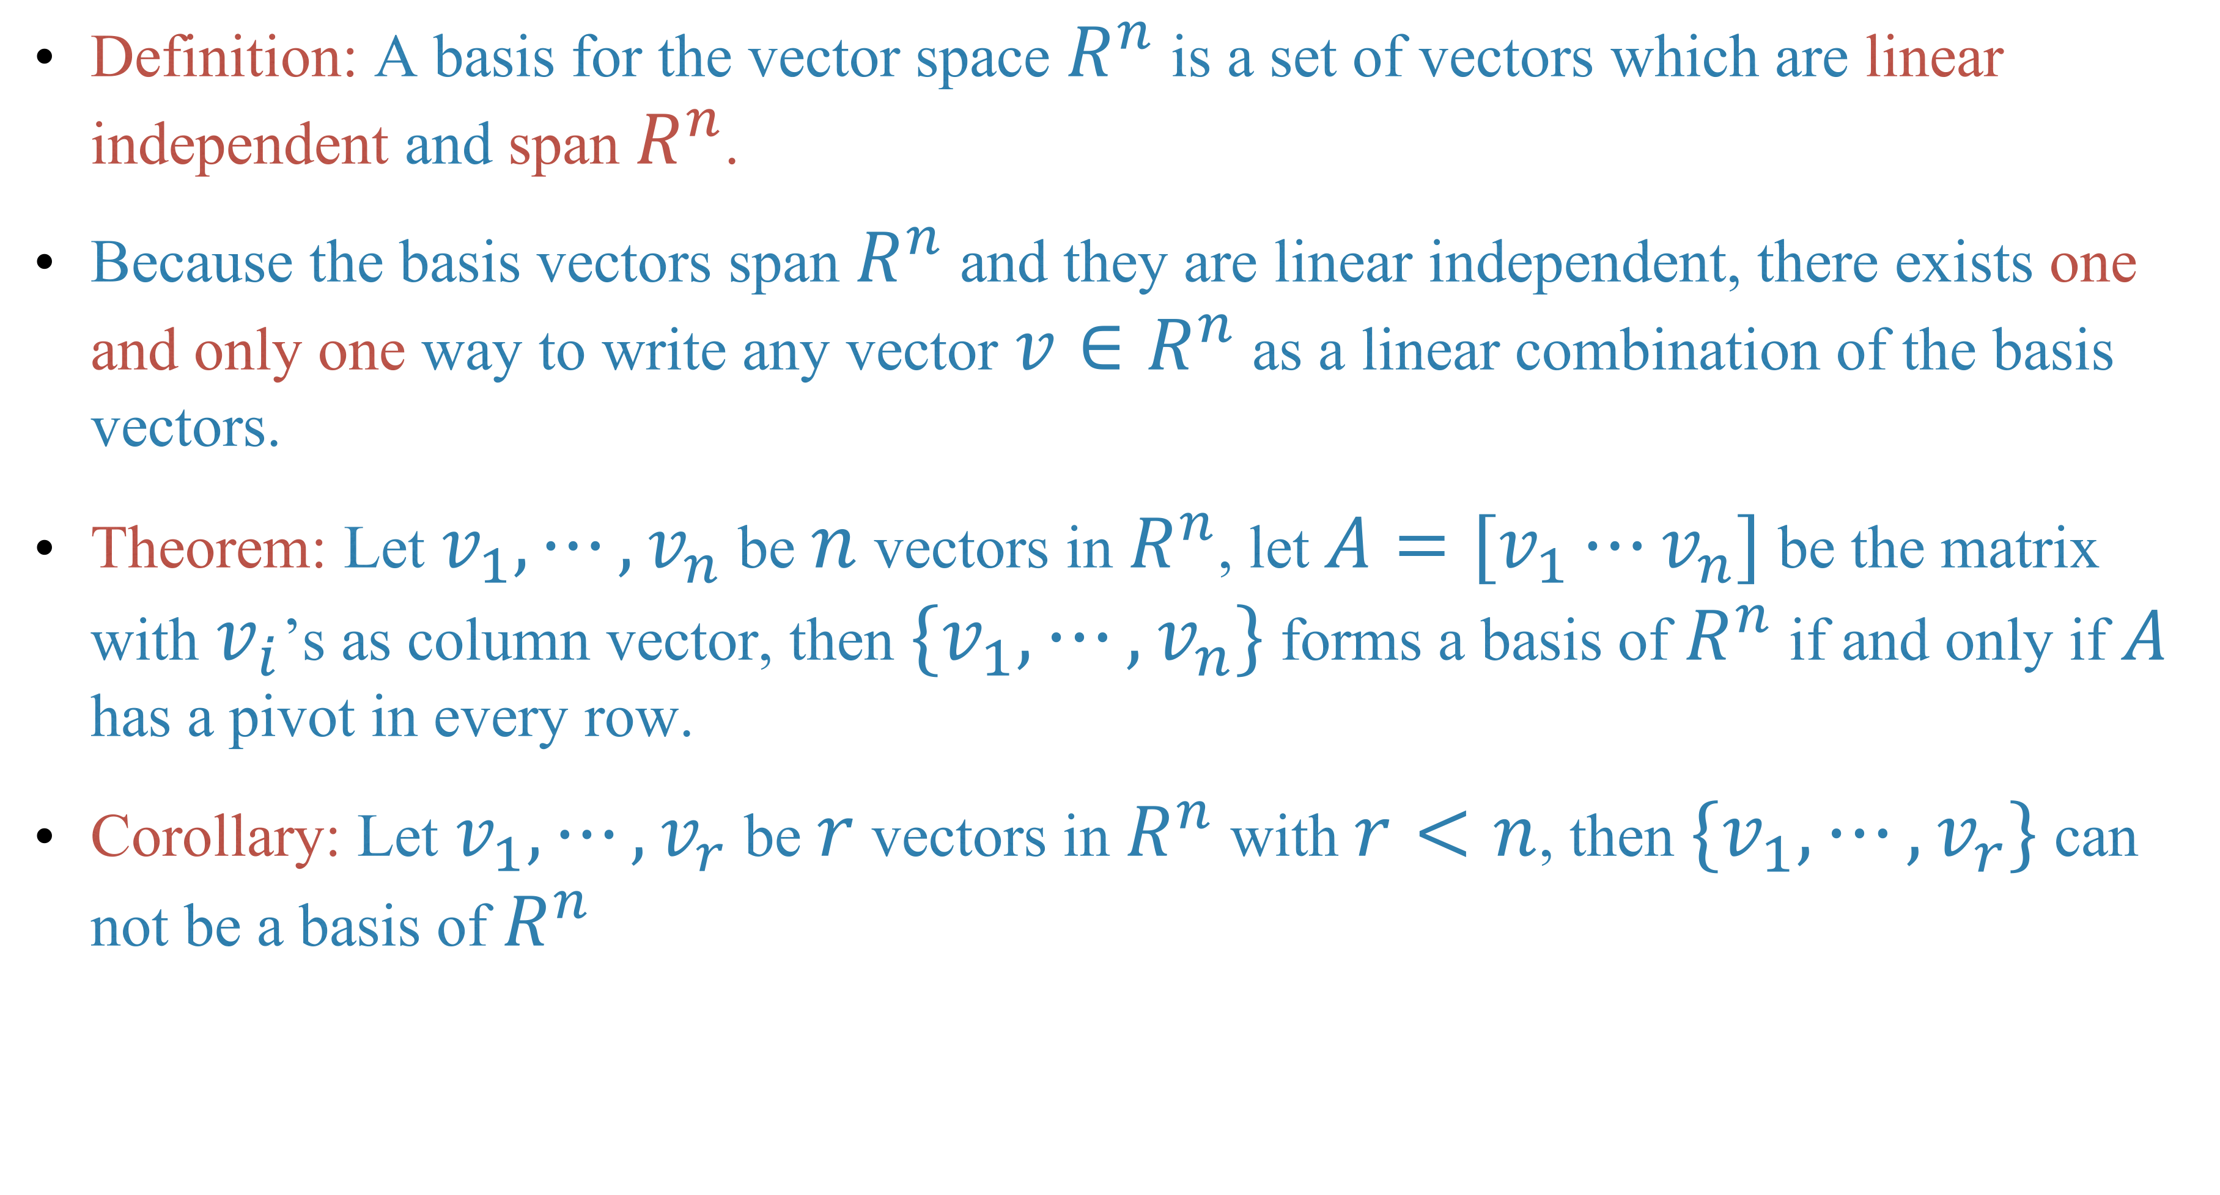

Definition: A basis for the vector space $R^{n}$ is a set of vectors which are linear independent and span $R^{n}$.
Because the basis vectors span $R^{n}$ and they are linear independent, there exists one and only one way to write any vector $v∈R^{n}$ as a linear combination of the basis vectors.
Theorem: Let $v_{1},⋯,v_{n}$ be $n$ vectors in $R^{n}$, let $A=[v_{1}⋯v_{n}]$ be the matrix with $v_{i}$’s as column vector, then $\{v_{1},⋯,v_{n}\}$ forms a basis of $R^{n}$ if and only if $A$ has a pivot in every row.
Corollary: Let $v_{1},⋯,v_{r}$ be $r$ vectors in $R^{n}$ with $r<n$, then $\{v_{1},⋯,v_{r}\}$ can not be a basis of $R^{n}$

Slide 6
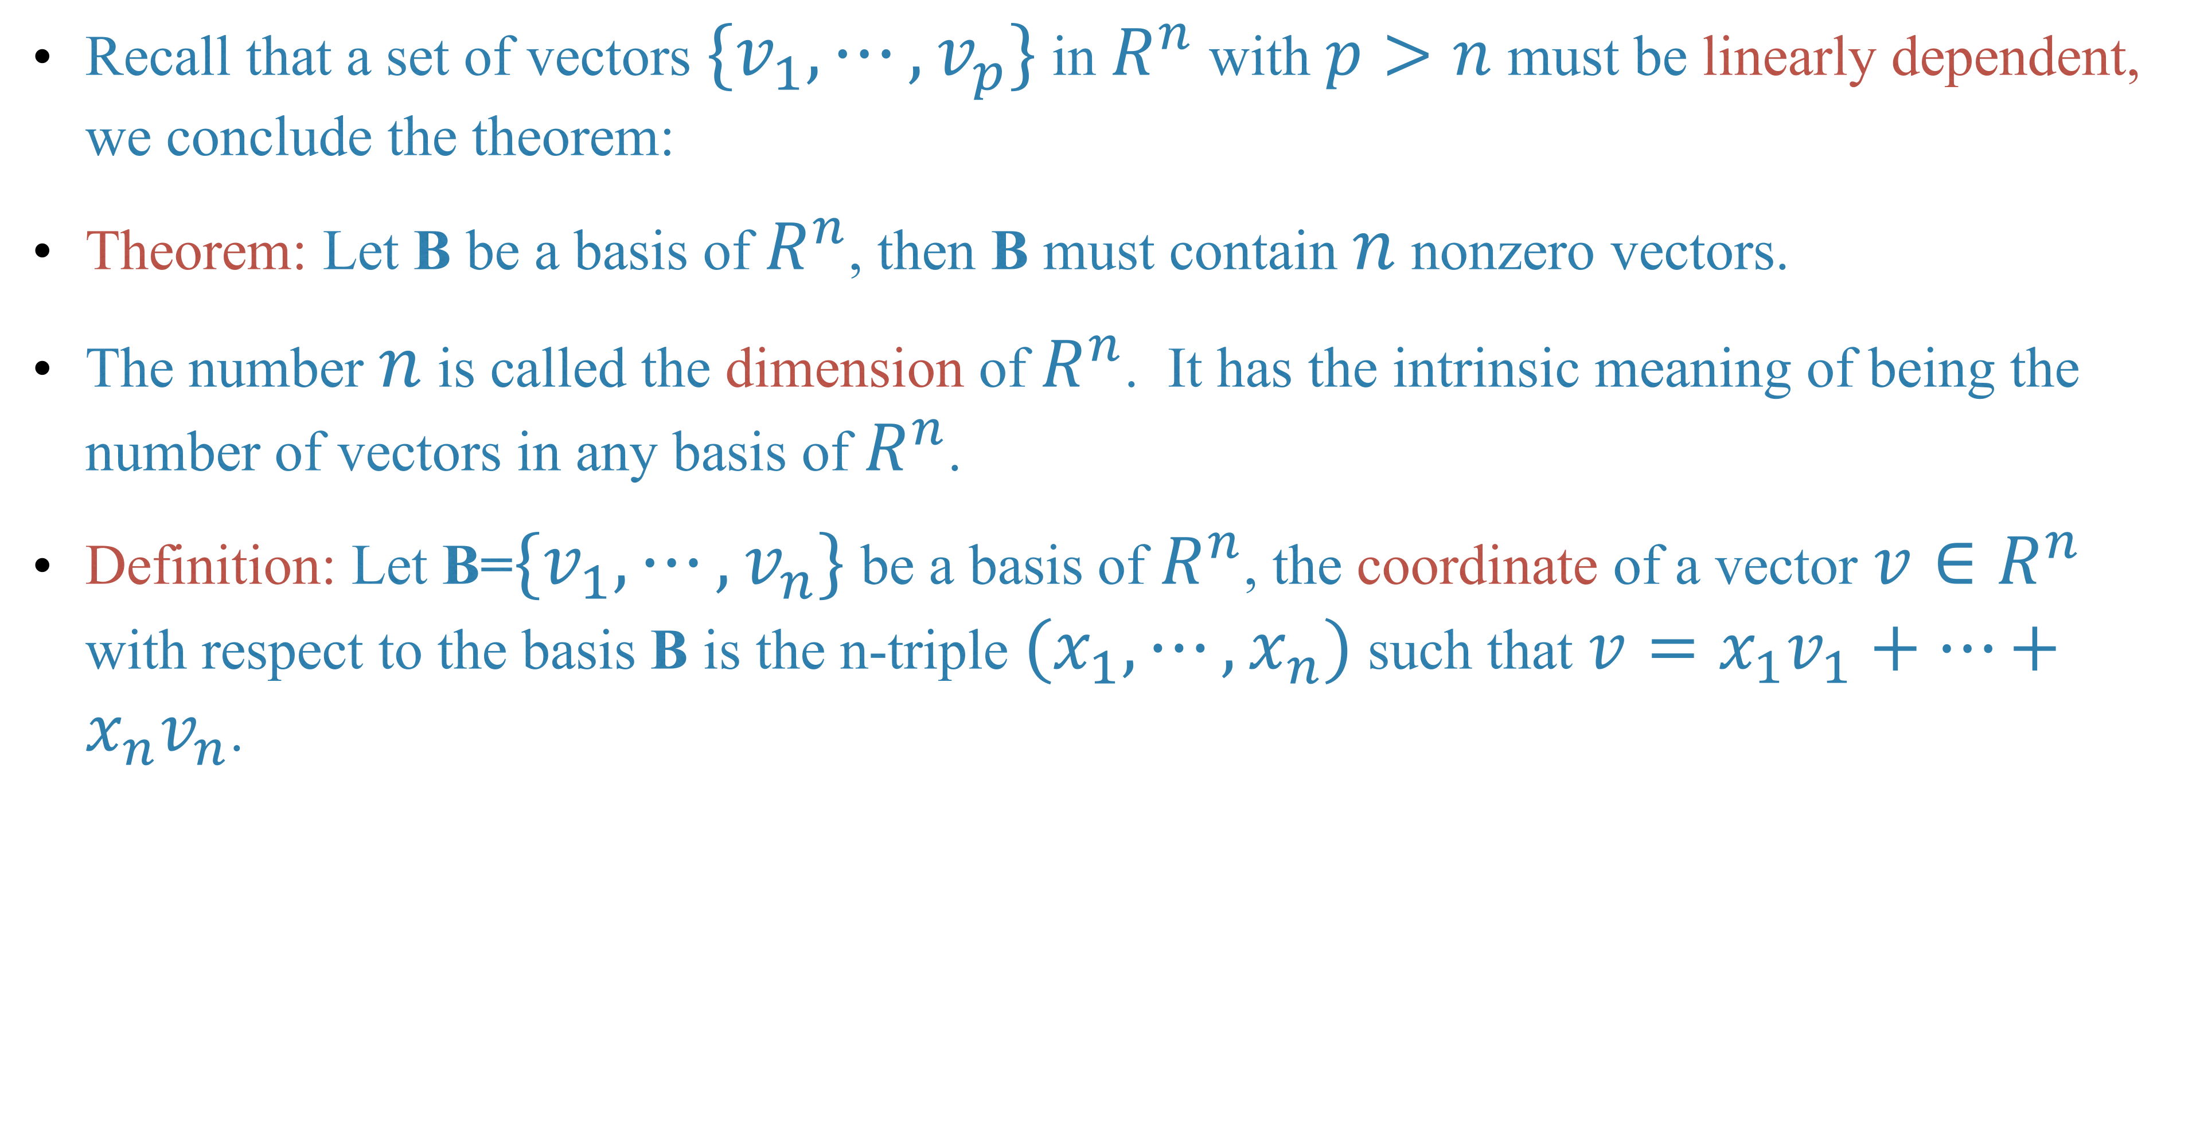
Recall that a set of vectors $\{v_{1},⋯,v_{p}\}$ in $R^{n}$ with $p>n$ must be linearly dependent, we conclude the theorem:
Theorem: Let B be a basis of $R^{n}$, then B must contain $n$ nonzero vectors.
The number $n$ is called the dimension of $R^{n}$. It has the intrinsic meaning of being the number of vectors in any basis of $R^{n}$.
Definition: Let B=$\{v_{1},⋯,v_{n}\}$ be a basis of $R^{n}$, the coordinate of a vector $v∈R^{n}$ with respect to the basis B is the n-triple $(x_{1},⋯,x_{n})$ such that $v=x_{1}v_{1}+⋯+x_{n}v_{n}$.

Slide 7
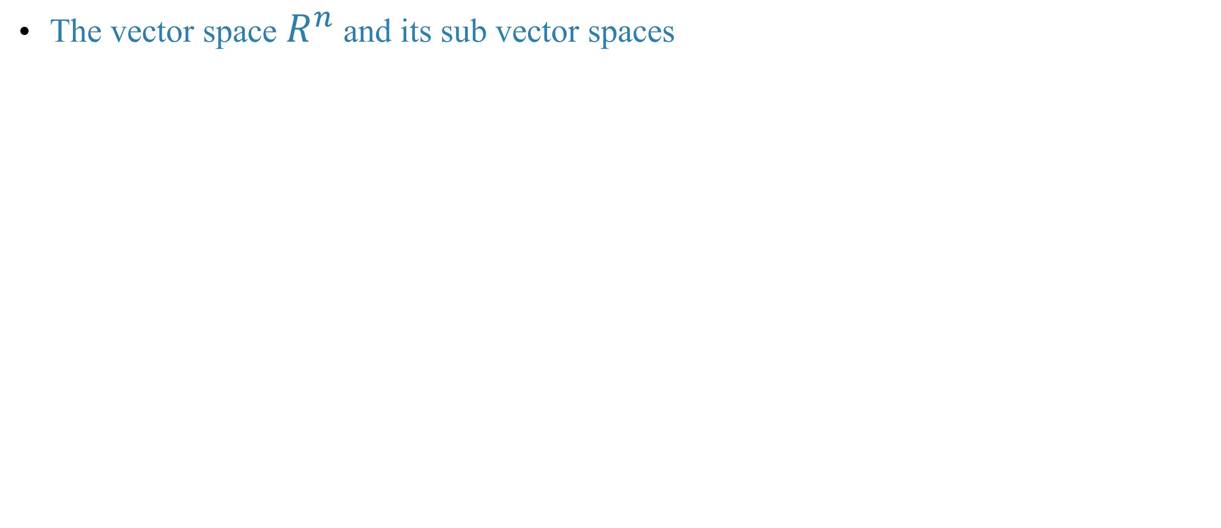
Vector space and subspaces
The vector space $R^{n}$ and its sub vector spaces

Slide 8
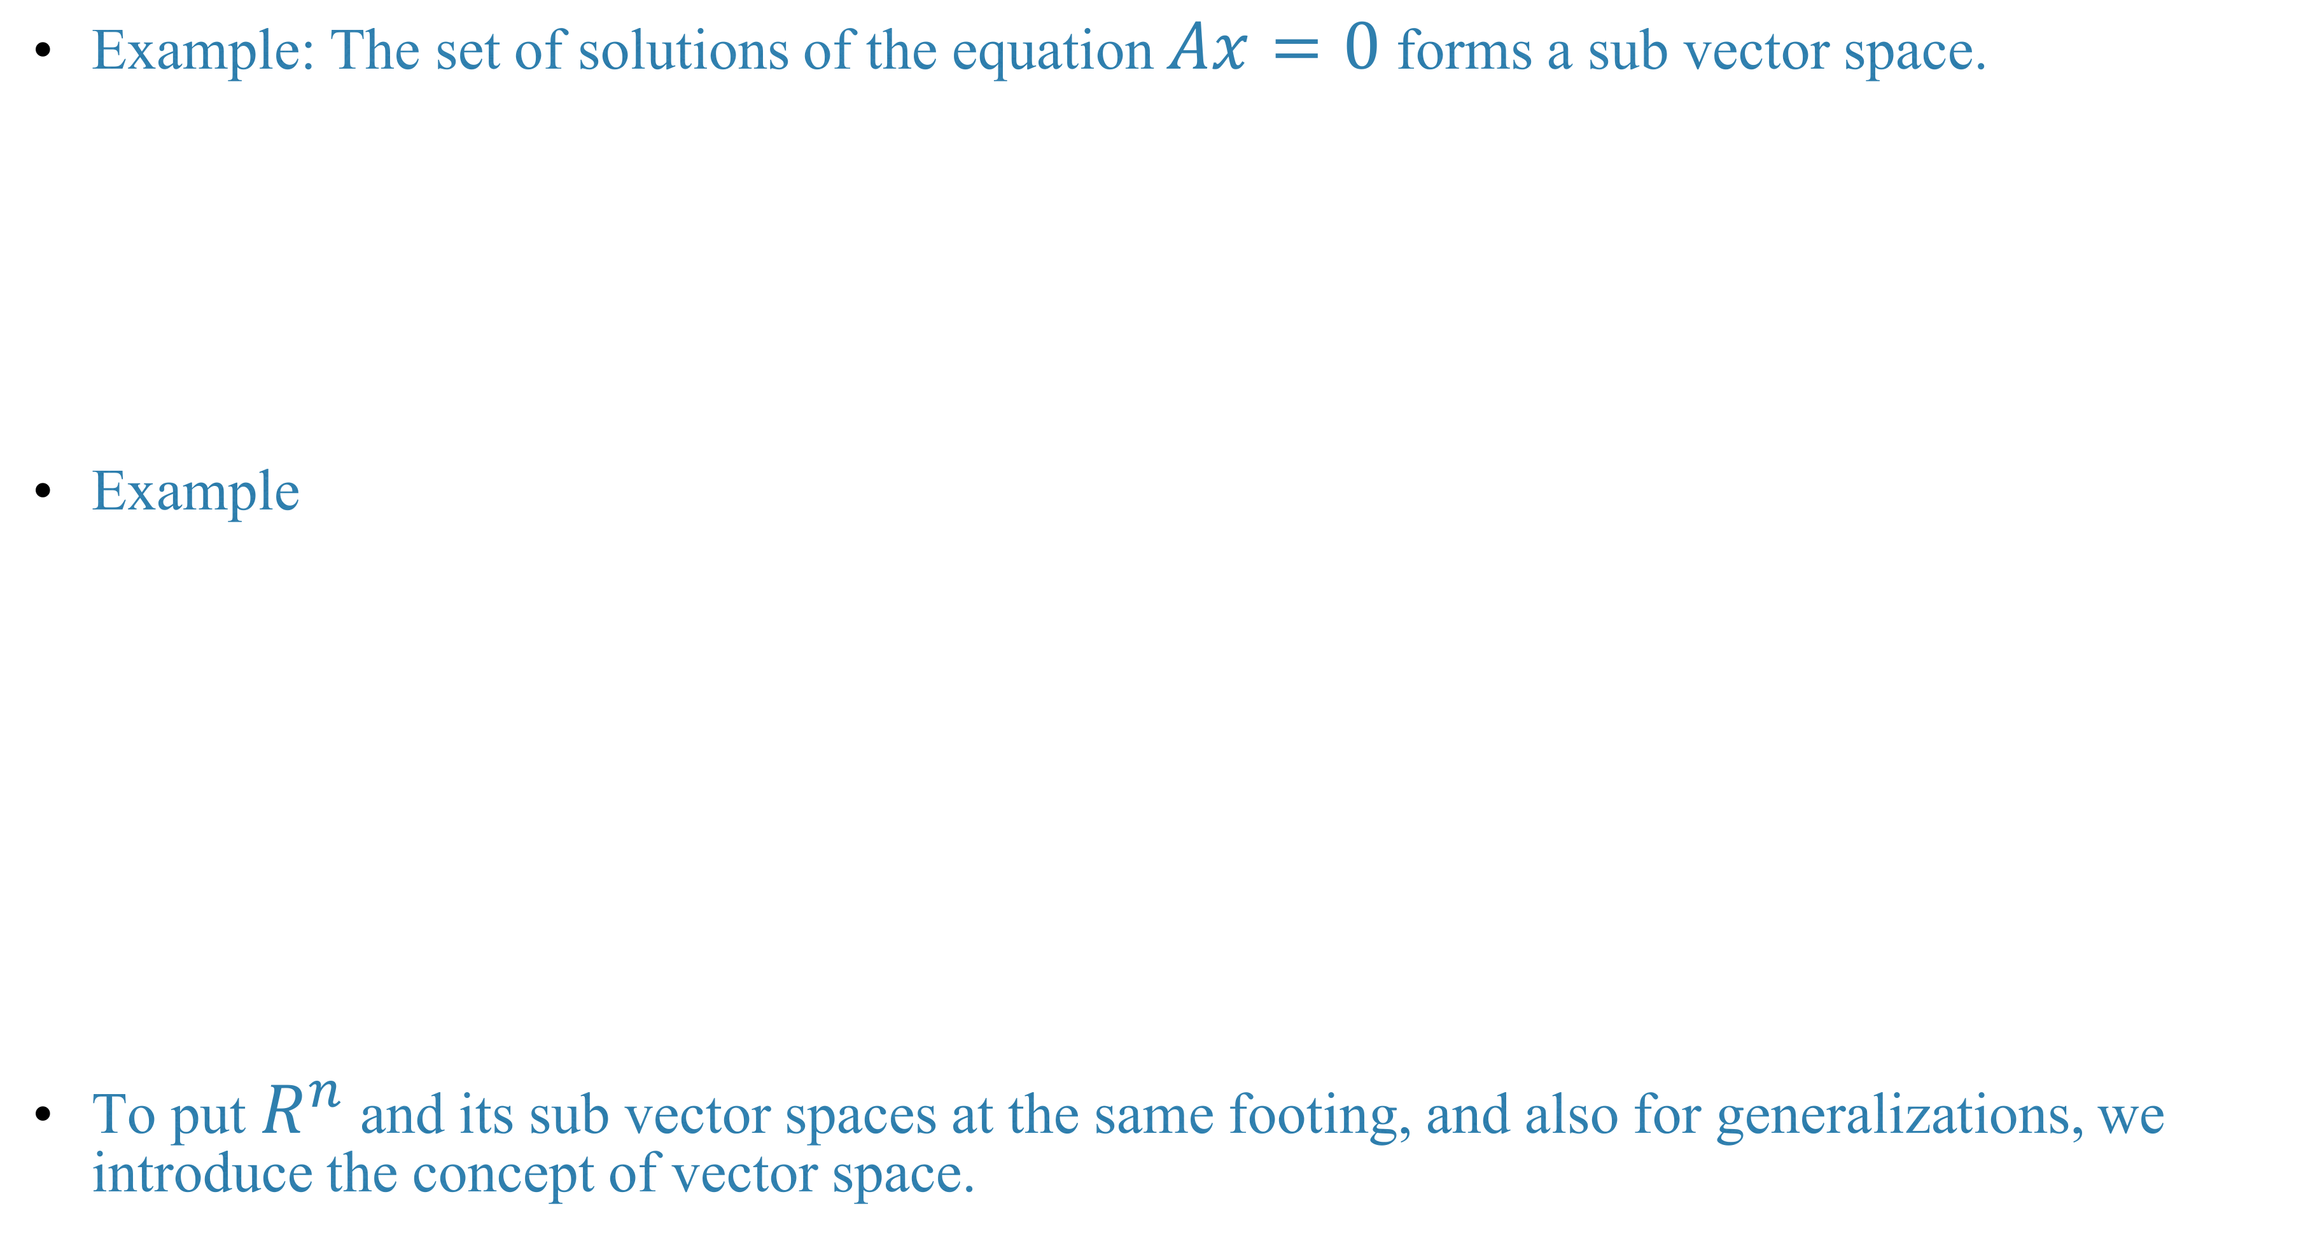
Example: The set of solutions of the equation $Ax=0$ forms a sub vector space.
Example
To put $R^{n}$ and its sub vector spaces at the same footing, and also for generalizations, we introduce the concept of vector space.

Slide 9
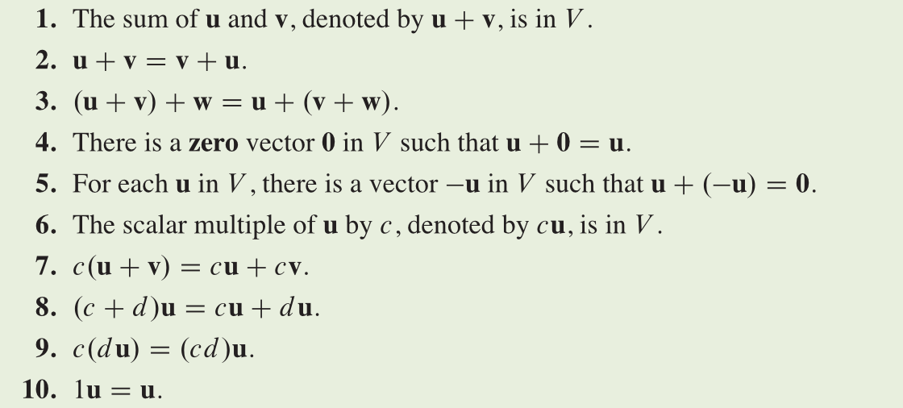
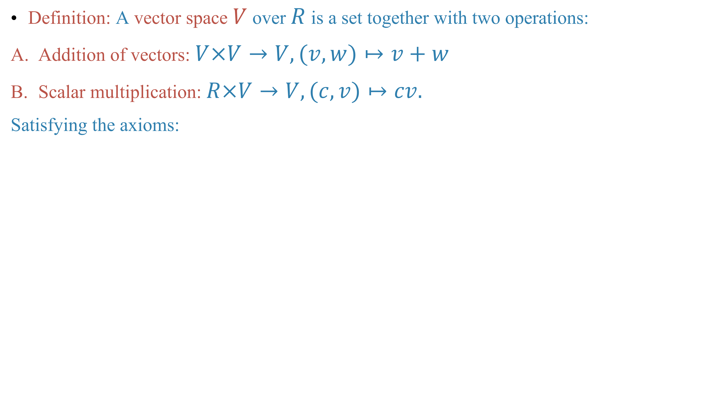
Definition: A vector space $V$ over $R$ is a set together with two operations:
Addition of vectors: $V×V→V,(v,w)↦v+w$
Scalar multiplication: $R×V→V,(c,v)↦cv.$
Satisfying the axioms:

Slide 10
Examples: The vector space of polynomials

Slide 11
Example: The vector space of real-valued functions on a set S.

Slide 12
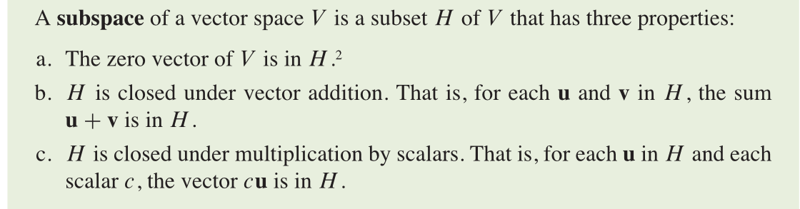
Remark: Similarly, we can define the complex vector space, by replacing the real numbers by complex numbers.
In the above examples, if we replace real coefficient polynomials by complex coefficient polynomials, or real-valued functions by complex-valued functions, we get corresponding complex vector spaces.
Similarly, we can define the concept of sub vector space.

Slide 13
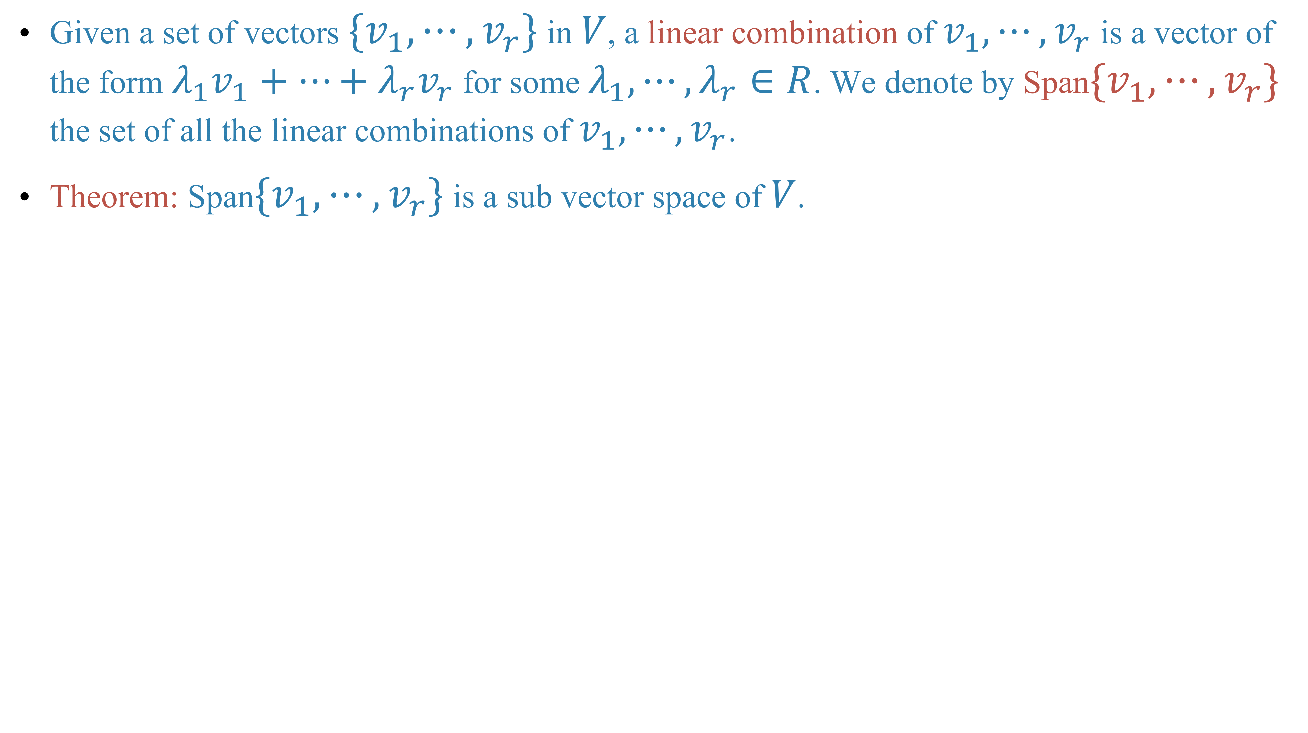
Given a set of vectors $\{v_{1},⋯,v_{r}\}$ in $V$, a linear combination of $v_{1},⋯,v_{r}$ is a vector of the form $λ_{1}v_{1}+⋯+λ_{r}v_{r}$ for some $λ_{1},⋯,λ_{r}∈R$. We denote by Span$\{v_{1},⋯,v_{r}\}$ the set of all the linear combinations of $v_{1},⋯,v_{r}$.
Theorem: Span$\{v_{1},⋯,v_{r}\}$ is a sub vector space of $V$.

Slide 14
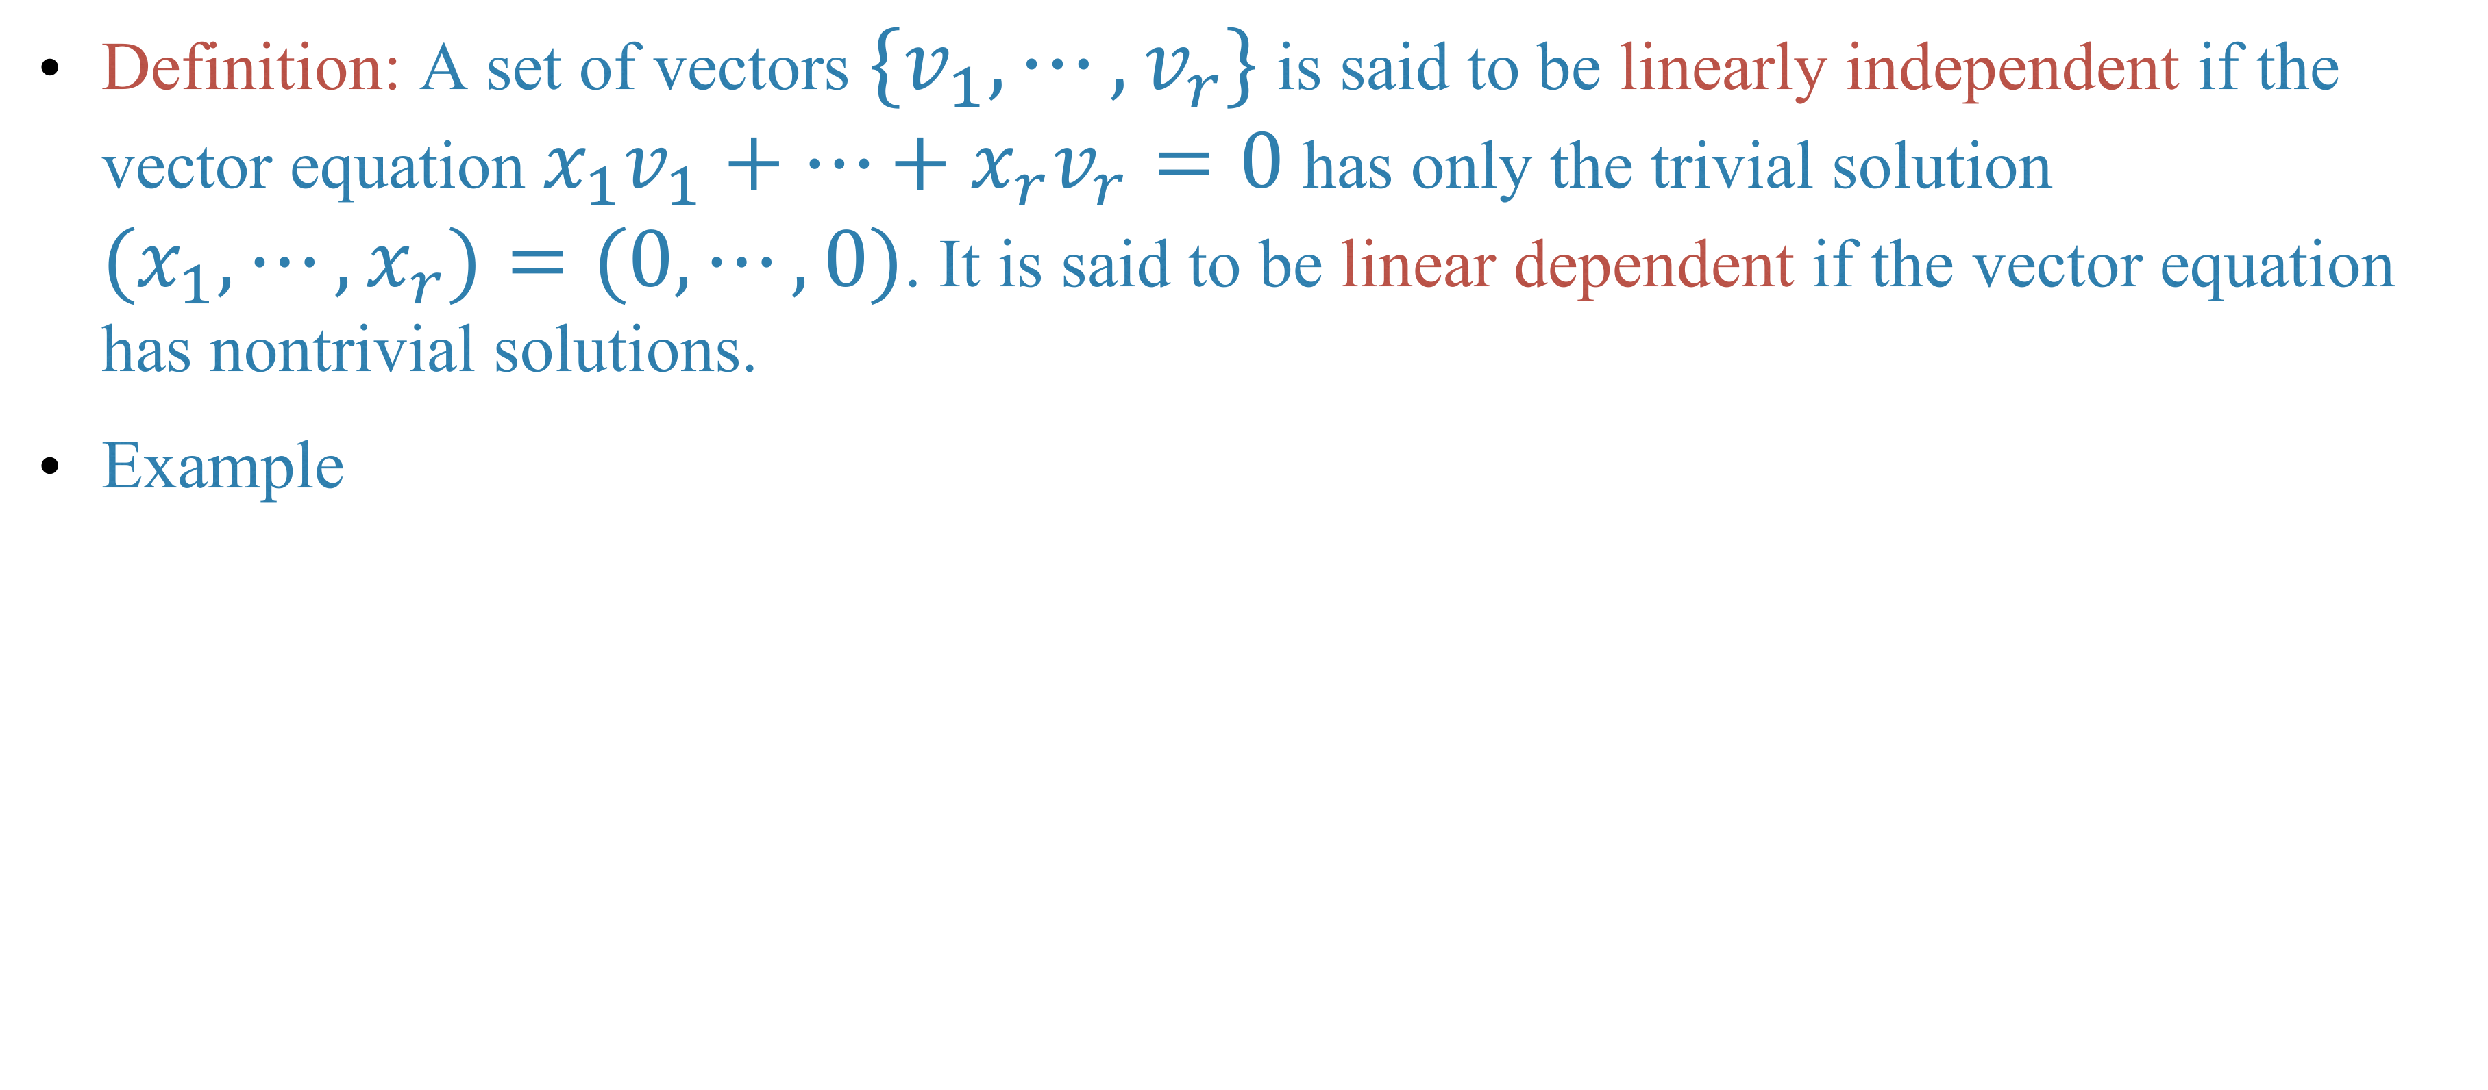
Linear independence, bases and dimension
Definition: A set of vectors $\{v_{1},⋯,v_{r}\}$ is said to be linearly independent if the vector equation $x_{1}v_{1}+⋯+x_{r}v_{r}=0$ has only the trivial solution $(x_{1},⋯,x_{r})=(0,⋯,0)$. It is said to be linear dependent if the vector equation has nontrivial solutions.
Example

Slide 15
Example:

Slide 16
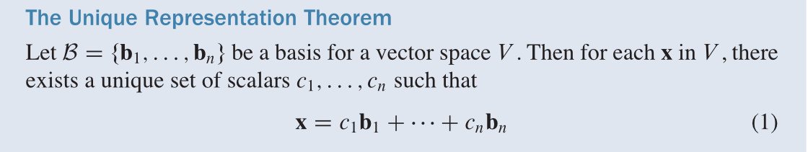
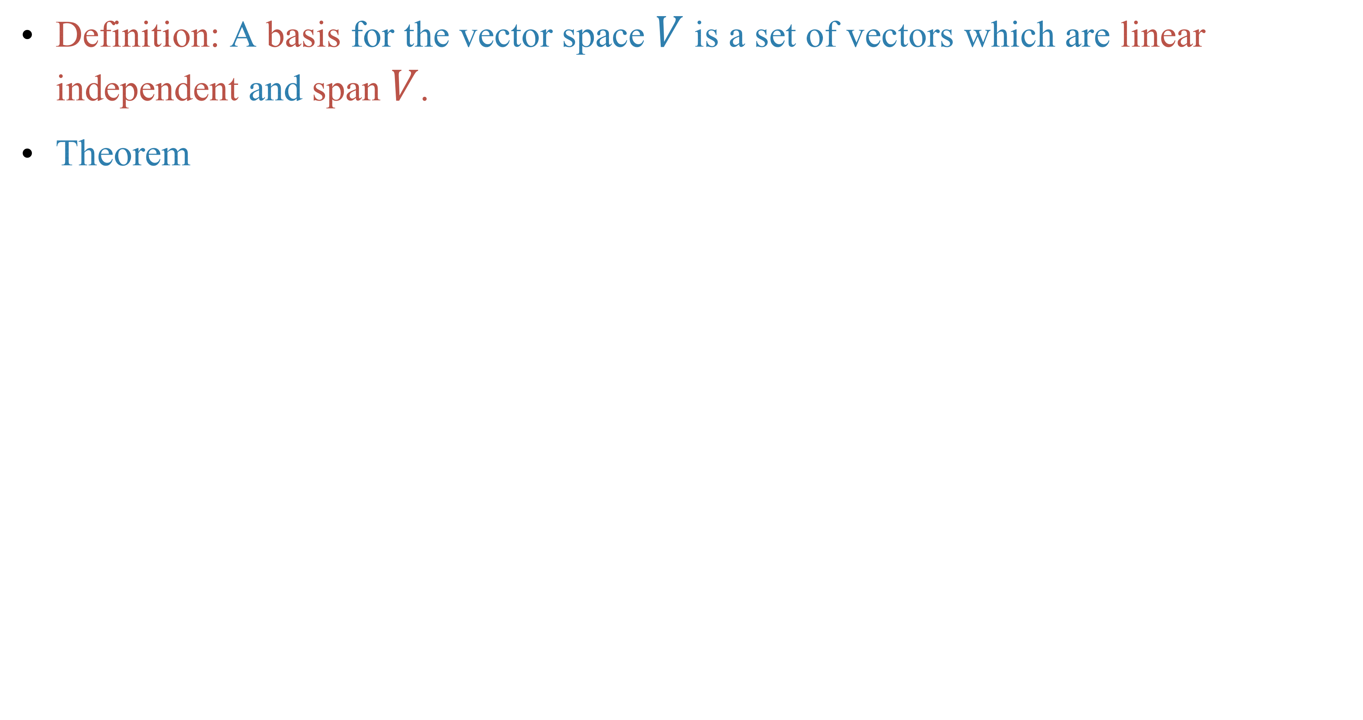
Definition: A basis for the vector space $V$ is a set of vectors which are linear independent and span $V$.
Theorem

Slide 17
Example

Slide 18
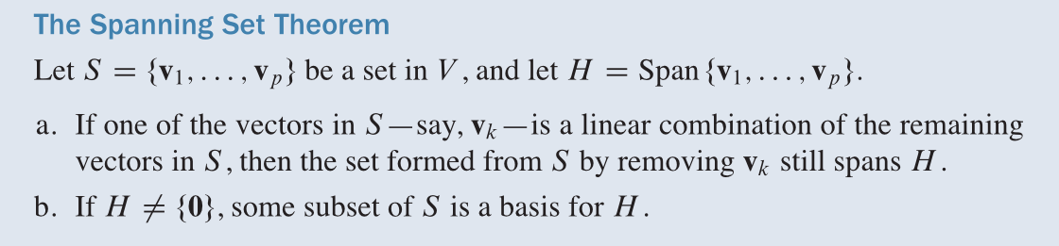
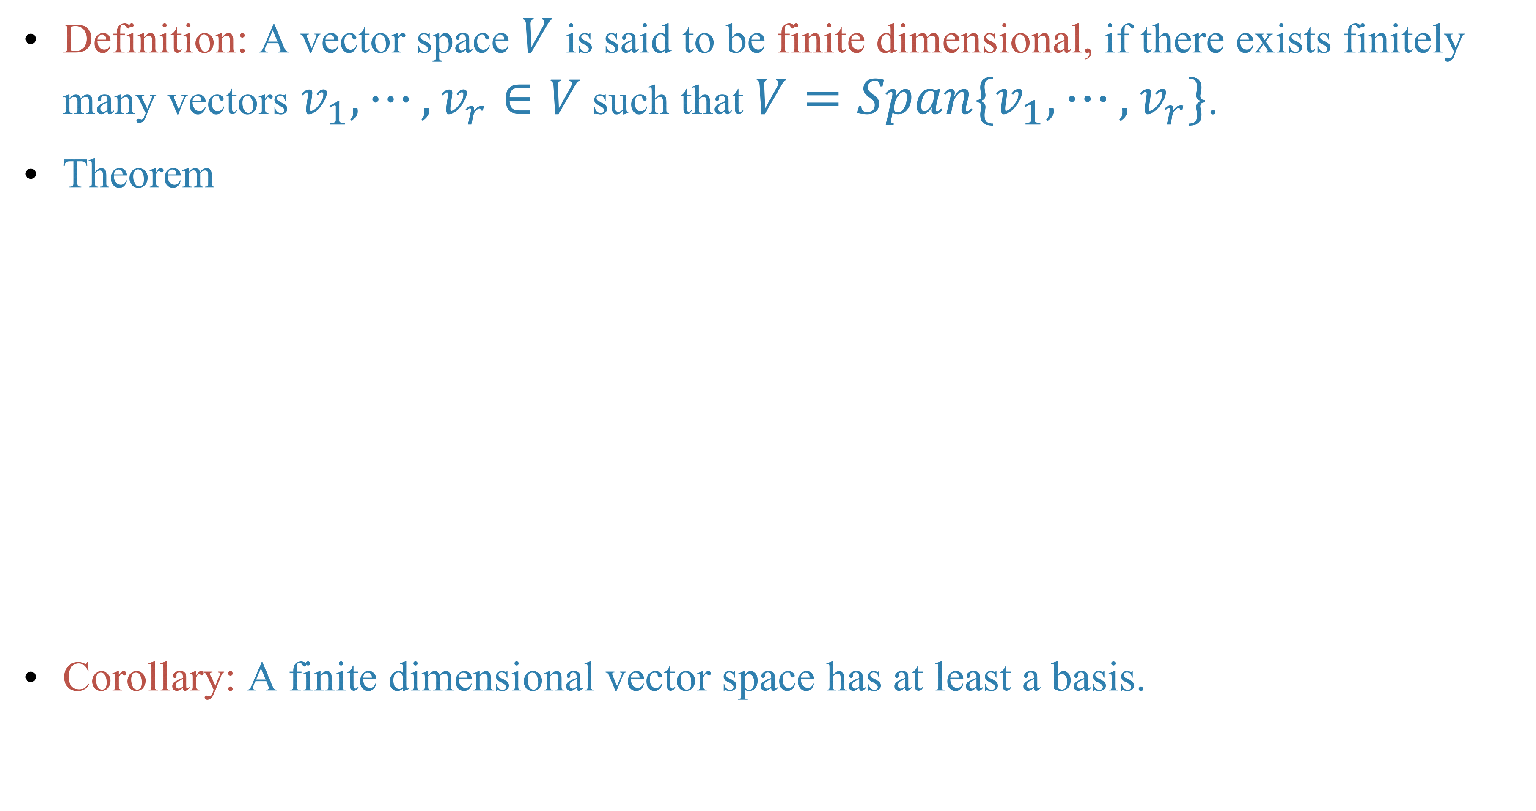
Definition: A vector space $V$ is said to be finite dimensional, if there exists finitely many vectors $v_{1},⋯,v_{r}∈V$ such that $V=Span\{v_{1},⋯,v_{r}\}$.
Theorem
Corollary: A finite dimensional vector space has at least a basis.

Slide 22
The dimension of a vector space
Theorem

Slide 24
Theorem

Slide 25
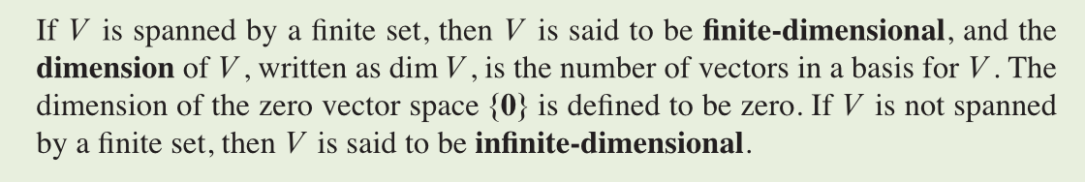
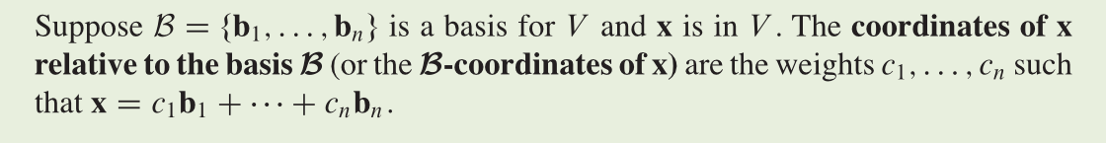
The number of vectors in a basis of a vector space is then an invariant of the vector space. We formalize it in the definition:
Definition

Slide 26
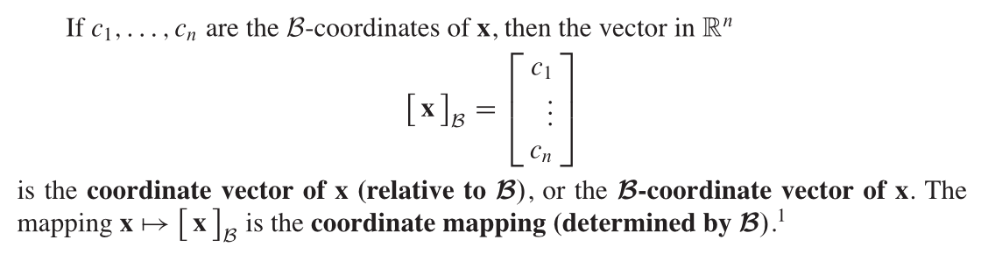

Slide 27
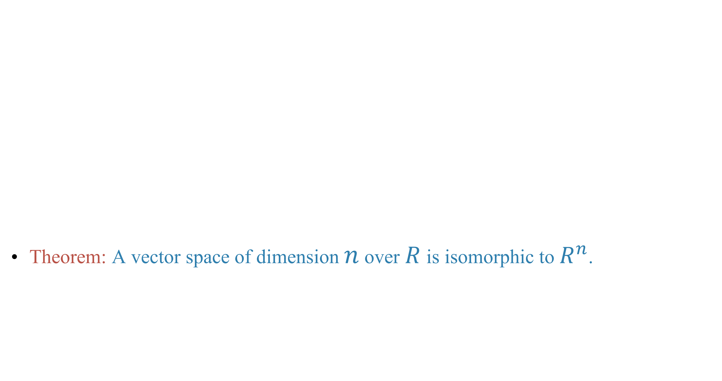
Theorem: A vector space of dimension $n$ over $R$ is isomorphic to $R^{n}$.

Slide 28
Example

Slide 29
Next time
Lay-Lay-McDonald, 1.8-1.9.

Slide 30
Homework
Lay-Lay-McDonald, chapter 4, 4.1 Exercises, question 2, 5, 6, 7, 8, 32.
Lay-Lay-McDonald, chapter 4, 4.3 Exercises, question 33.
Lay-Lay-McDonald, chapter 4, 4.4 Exercises, question 27, 28.

